Slide 1

AUTOMIZED SEQUENCE PLANNING IN AUTOMOTIVE PRODUCTION WITH AI

Slide 2


Table of contents
01
02
03
04
05
FAILURES OF PREVIOUS
ATTEMPT
MOTIVATION
& GOALS
CURRENT
STATE
TARGET
STATE
CONCLUSION
(real case)
Challenges
Solutions

Slide 3

Motivation & goals
01
02
03
REDUCTION
OF WORKLOAD
OPTIMIZED STOCK
IN PRODUCTION
REDUCE LEAD TIME

Slide 4

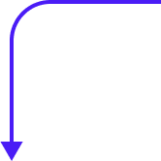
Current state
PRE PRODUCTION
END PRODUCTION
Manuel sequencing per production line (once per week)
PRE PRODUCTION PLANNING SYSTEM
END PRODUCTION PLANNING SYSTEM
SAP
COSTUMER DEMAND VIA EDI

Slide 5
Current state
PRE PRODUCTION
END PRODUCTION
Continouse AI planning
PRE PRODUCTION PLANNING SYSTEM
END PRODUCTION PLANNING SYSTEM
SAP
COSTUMER DEMAND VIA EDI

Slide 6

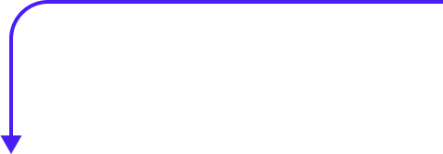
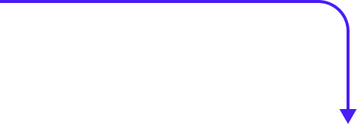

Challenges
1
Retrieving necessary (historic) data
CYCLE TIME
FOR PRODUCT
PER LINE
AVAILABILITY
OF STAFF
PRODUCEABLE PRODUCTS
PER LINE
MACHINE AVAILABILITY
CUSTOMER DEMAND
SAP
Personell
planning system
Excel
Production
System
Production
System
Need to combine several data sources from different department

Slide 7
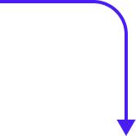
Challenges
2
Short-term pull-ins from customer
Capacity constraints
CUSTOMER DEMAND HIGHER THAN AVAILABLE CAPACITY
MACHINE
FAILURE
MATERIAL
SHORTAGE
Need to priorize demand of customer

Slide 8

Challenges
3
Get in-depth expert knowledge from employees who will be relocated after the system is implemented
Avoid resistаnce of affected employees

Slide 9

Solutions
1
PROBLEM: Combine several data sources from different department
01
02
03
Employ CDO that has the power to access all data sources without time consuming IT department approval
is available)
In general: Avoid
using excel for data storage (e.g. use different source for machine availability)
New data-warehouse for combined data

Slide 10

Solutions
2
PROBLEM: Need to prioritize demand of customer
CASE 1
CASE 2
LACK OF DATA
SUFFICIENT DATA
Combine expert system with machine learning (prioritize rule based when not enough historic data
is available)
Use machine learning exclusively without rule based constraints

Slide 11
Solutions
3
PROBLEM: Resistance of affected employees
01
02
Explain that they will profit from the change by getting rid of monotonous tasks
Employee training
on new digital work environment
Change management

Slide 12


Failures of previous attempt
Real Case
Outsource development
of AI system
Expectation of management
Implementation in production within weeks
No insight knowledge
Too few test meetings
Low budget

